Slide 1

MULTI-AGENT · LLM-ORCHESTRATED · RETRIEVAL-AUGMENTED
Automated Content Generation System
Lexora AI — Multi-Agent LLM-Orchestrated Content Generation Platform
SUBMITTED BY
COURSE / PROGRAM
Ahmed Farag
Ahmed Farag
Ahmed Amir Mohamed
Farha Mostafa Asran
Arwa Alaa El Hassan
DEPI Generative & Agentic AI Track
GROUP
CAI4_AIS3_S4
REPOSITORY
Supervised by: Noor El Deen Magdy
github.com/nhahub/NHA-4-119
Automated Content Generation System · DEPI CAI4_AIS3_S4
1
Notes:
1

Slide 2
ROADMAP
Agenda
1
Problem
6
Implementation
2
Project Objective
7
API & Deployment
3
Proposed Solution
8
Testing & Results
4
System Architecture
9
Challenges
5
Agentic Workflow
10
Future Work
Automated Content Generation System · DEPI CAI4_AIS3_S4
2
Notes:
Quick overview of what we'll cover: the problem we're solving, our objective, the Lexora AI solution, its architecture and agent workflow, how it's implemented, tested, and deployed, and finally challenges and future work.
2

Slide 3




SECTION 1 · THE PROBLEM
The Content Creation Challenge
Constant Demand
Manual Writing Is Slow
Businesses need fresh content daily across blogs, social platforms, and email — for every channel, every week.
Producing well-structured, platform-appropriate content by hand is time-consuming and hard to scale across a team.
Generic AI Falls Short
No Scalable Workflow
Off-the-shelf AI tools often lack structure, a built-in quality check, or grounding in current facts.
Teams need a repeatable, automated pipeline — not a single prompt — to go from topic to publish-ready draft.
Automated Content Generation System · DEPI CAI4_AIS3_S4
3
Notes:
Businesses need constant content across many channels. Writing it by hand doesn't scale, and generic AI tools produce generic, ungrounded output. There's a real need for a structured, automated, quality-checked content workflow.
3

Slide 4
SECTION 1 · THE PROBLEM
The Content Creation Crisis
Why businesses are losing the content war
4.4M
4-8hrs
$2K+
10×
Blog posts published
every single day
Average time to write
one quality article
Cost per article from
content agencies
Content demand growth
since 2020
Businesses need fresh content daily across blogs, social media, and email campaigns
Human writers are slow and expensive — completely unviable at enterprise scale
Generic AI tools lack domain awareness and produce off-brand content
Marketing teams face an impossible task: one team, a lot of content types, zero time
Generative AI Track 2026
Farha Mostafa · Ahmed Alsayed · Ahmed Mohamed · Ahmed Amir · Arwa Alaa
Notes:
The content creation problem is massive. 4.4 million blog posts are published daily. Writing quality content takes 8 hours on average. Content agencies charge $2,000+ per article. And content demand has grown 10x since 2020. Marketing teams are overwhelmed. They need more content than ever, but human writers are too slow and too expensive. Generic AI tools exist but they produce forgettable, unfocused, off-brand content.
4

Slide 5
SECTION 2 · CURRENT MARKET LIMITATIONS
Why Existing Solutions Fall Short
Human Writers
Generic AI Tools
Lexora AI
✕ Slow — hours per article
✕ One-size-fits-all output
✓ Unified multi-format platform
✕ Very expensive at scale
✕ No content-type specialization
✓ Domain-specific Phi-3 fine-tuning
✕ Inconsistent quality
✕ Lacks fine-tuned domain focus
✓ 3 curated specialized datasets
✕ Cannot handle high volume
✕ Generic
✓ Self-hosted, low inference cost
The market needs a specialized, fine-tuned, multi-AI content platform.
Generative AI Track 2026
Farha Mostafa · Ahmed Alsayed · Ahmed Mohamed · Ahmed Amir · Arwa Alaa
Notes:
Looking at the competitive landscape: Human writers are too slow and too expensive for scale. Generic AI tools like ChatGPT are not specialized — they produce mediocre, unfocused content. ContentForge AI fills the gap with domain-specific fine-tuning, three specialized datasets, and a unified multi-format architecture.
5

Slide 6




SECTION 2 · GOAL
Project Objective
Build an automated content generation system that turns a topic into a finished, platform-ready draft.
Accept requests through API, so the system can be integrated into any workflow or tool.
Use multiple cooperating AI agents for planning, research, writing, and quality review — not a single prompt.
Support multiple content types: blog, LinkedIn, tweet, Instagram, and short story.
Make the system testable, containerised, and extensible for future growth.
Automated Content Generation System · DEPI CAI4_AIS3_S4
4
Notes:
Our objective: an API-driven, multi-agent system that plans, researches, writes, and reviews content across five formats, built to be testable and containerised from day one.
6

Slide 7




SECTION 3 · OUR SOLUTION
Introducing Lexora AI
A multi-agent, LLM-orchestrated pipeline that turns a request into platform-ready content.
User Request
API
Background Job
LangGraph Agents
Generated Content
Supported Content Types
Blog
LinkedIn
Tweet
Instagram
Short Story
Automated Content Generation System · DEPI CAI4_AIS3_S4
5
Notes:
Lexora AI takes a user request through FastAPI, queues it as a background job, runs it through a LangGraph agent pipeline, and returns generated content the user can retrieve. It supports five content types: blog, LinkedIn, tweet, Instagram, and short story.
7

Slide 8
SECTION 4 · ARCHITECTURE
Fine-Tuned LLM Strategy
GPT-2 Experiment:
Model: GPT-2
Dataset: roneneldan/TinyStories
Task: Short story generation
Training sample: 2% of dataset
Train / Validation: 42,394 / 439
Epochs: 3
Batch size: 8
Learning rate: 5e-5
Max length: 512 tokens
Eval loss: 1.49
Phi-3 QLoRA Direction:
Model: Phi-3-mini-4k Instruct
Parameters: 3.8B
Method: PEFT / QLoRA
Quantization: 4-bit NF4
LoRA: r=16, alpha=32
Learning rate: 2e-4
Epochs: 3 per content type
Datasets: Blog Authorship Corpus, SimpleStories, NeuML LinkedIn
Fine-tuning was explored as a local model strategy, while the delivered platform mainly uses a multi-agent workflow with OpenRouter by default and optional local Phi-3 adapters.

Slide 9
SECTION 4 · ARCHITECTURE
High-Level System Architecture
User / Client
LangGraph Agent Pipeline
Key Idea
Outline Agent
Fine tune LLM
The client never waits on generation — FastAPI returns a job ID immediately while the LangGraph pipeline runs in the background.
FastAPI Backend
Search Agent
API Routers
health · generate · jobs
Tavily Search API
Router Agent
Background Job Service
Writer Agent
Critique Agent
Job Store / Database
(PostgreSQL + memory fallback)
Docker Deployment Layer (Dockerfile + docker-compose)
Automated Content Generation System · DEPI CAI4_AIS3_S4
6
Notes:
The client talks to FastAPI, which creates a job and hands it to a background service. That service runs the LangGraph agent pipeline, which calls OpenRouter for language generation and Tavily for search, and everything is persisted to the job store. The whole backend runs in Docker.
8

Slide 10
SECTION 5 · AGENTIC WORKFLOW
How a Request Becomes Content
The pipeline is sequential end-to-end — each agent's output feeds the next.
User Request
FastAPI
POST /generate
Create Job
Background
Task
Outline
Agent
Search Agent
+ Tavily
Router
Agent
Writer
Agent
Critique
Agent
Revision Loop
(if needed)
Store Result
User Retrieves
Result
Max 3 revision cycles before the pipeline terminates and the result is stored.
Note: The Outline and Search agents run sequentially, not in parallel — Outline completes first, then Search runs using its output.
Automated Content Generation System · DEPI CAI4_AIS3_S4
7
Notes:
This is the real, sequential workflow from graph.py: Outline runs first, then Search, then Router picks a writer, the Writer drafts, and Critique reviews — looping back up to three times if needed. Outline and Search are not parallel.
9

Slide 11





SECTION 5 · AGENTIC WORKFLOW
Agents and Responsibilities
1
2
3
4
5
Outline Agent
Search Agent
Router Agent
Writer Agent
Critique Agent
Builds the content structure and core argument before any prose is written.
Retrieves supporting information and citations using Tavily web search.
Selects the correct writer agent based on the requested content type.
Generates platform-specific content — one specialised writer per content type.
Reviews and scores the draft, triggering revision cycles up to a limit of three.
Automated Content Generation System · DEPI CAI4_AIS3_S4
8
Notes:
Five agents, each with one job: Outline plans structure, Search grounds it in real information, Router picks the right writer, the Writer drafts the content, and Critique reviews it and can send it back for revision, up to three times.
10

Slide 12
SECTION 5 · AGENTIC WORKFLOW
Supported Content Types
Blog
LinkedIn
Tweet
Instagram
Short Story
Structured, long-form content with sections and a clear narrative arc.
Professional post tone, written for engagement on a business network.
Short-form social content, single tweet or thread as appropriate.
Caption-style social content optimised for visual platforms.
Creative narrative content with its own writer and evaluation logic.
Each content type has its own dedicated prompt and writer agent — not one generic template.
Automated Content Generation System · DEPI CAI4_AIS3_S4
9
Notes:
Five content types are supported today, each with its own purpose-built writer agent and prompt — blog, LinkedIn, tweet, Instagram, and short story.
11

Slide 13
SECTION 6 · IMPLEMENTATION
Backend API Design
Method | Endpoint | Purpose
GET | / | Root info: name, version, status
GET | /health | Health check with readiness status
POST | /api/v1/generate | Queue a new generation job -> returns job_id
GET | /api/v1/jobs/{job_id} | Poll job status and progress
GET | /api/v1/jobs/{job_id}/result | Retrieve the final generated content
GET | /api/v1/jobs/{job_id}/debug | Retrieve full agent debug payload
Async, Job-Based Pattern
The client receives a job_id immediately after submitting a request. The actual generation runs in the background, so the caller polls the status endpoint and then retrieves the result once it's ready, instead of holding a long HTTP connection open.
1. Submit -> 202 Accepted + job_id
2. Poll -> status / progress
3. Retrieve -> final content
Automated Content Generation System · DEPI CAI4_AIS3_S4
10
Notes:
The API follows an asynchronous job pattern: submit a request, get a job ID right away, then poll for status and pull the result once it's done. Six endpoints cover health, generation, and job status/result/debug.
12

Slide 14

SECTION 6 · IMPLEMENTATION
Data and Persistence Layer
GenerationJob
PostgreSQL via SQLAlchemy
Tracks background job lifecycle: status, progress, timestamps
Schema evolved through Alembic migrations, including a rating field added later for future human feedback.
ContentGeneration
Normalised request configuration: topic, content_type, tone
In-Memory Fallback
GeneratedContent
If the database is unreachable, the job store automatically falls back to an in-process memory store for local development — unless strict-database mode is enabled.
Final clean content, revision count, rating field
GenerationDebugData
Full agent internals for debugging: outline, search, draft, critique
Automated Content Generation System · DEPI CAI4_AIS3_S4
11
Notes:
Four tables separate job lifecycle, request configuration, clean content, and debug internals. Persistence uses PostgreSQL through SQLAlchemy and Alembic, with an automatic in-memory fallback so local development isn't blocked by database availability.
13

Slide 15
SECTION 6 · IMPLEMENTATION
Technology Stack
Backend
FastAPI · Uvicorn · Pydantic
PLANNED / FUTURE
Agents
LangGraph
• MLflow (experiment tracking)
• Streamlit (interactive UI)
LLM Provider
OpenRouter (Llama 3.1 8B Instruct)
• CI/CD automation
Search
Tavily
Not yet implemented in the current repository — reserved folders / named in docs only.
Database
PostgreSQL · SQLAlchemy · Alembic
Testing
pytest · httpx / TestClient
Deployment
Docker · Docker Compose
Automated Content Generation System · DEPI CAI4_AIS3_S4
12
Notes:
The delivered stack: FastAPI backend, LangGraph agents, OpenRouter for language generation, Tavily for search, PostgreSQL persistence, pytest for testing, and Docker for deployment. MLflow, Streamlit, and CI/CD remain planned.
14

Slide 16
SECTION 6 · IMPLEMENTATION
Implementation Status
IMPLEMENTED
PLANNED / FUTURE WORK
✓
FastAPI backend & routing
○
Streamlit UI
✓
Background job architecture
○
MLflow tracking
✓
LangGraph agent pipeline
○
CI/CD automation
✓
OpenRouter integration
○
Formal human evaluation
✓
Tavily integration
○
Local fine-tuning / GAN comparison (superseded by agentic approach)
✓
Job store / database models
✓
Docker / Docker Compose
✓
API tests (pytest)
✓
Saved output samples
Automated Content Generation System · DEPI CAI4_AIS3_S4
13
Notes:
Nine major components are implemented and working end to end. Five capabilities remain planned or future work, including MLflow, Streamlit, CI/CD, formal human evaluation, and the original fine-tuning/GAN comparison, which was superseded by the agentic approach.
15

Slide 17
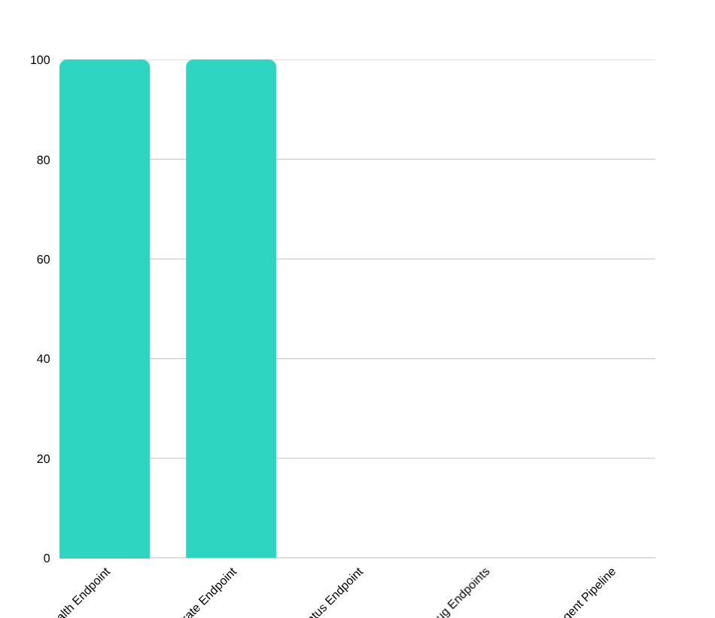
SECTION 7 · TESTING AND RESULTS
Testing and Quality Assurance
Health endpoint test — verifies readiness and status fields
Generate endpoint test — valid minimal request returns 202 + job_id
Missing required field validation (topic / content_type)
Invalid max_tokens validation (above allowed ceiling)
All API-layer tests run automatically with pytest and FastAPI's TestClient.
Automated Content Generation System · DEPI CAI4_AIS3_S4
14
Notes:
Automated tests currently cover the health and generate endpoints — validating success cases and rejecting invalid input. Job status, result, debug endpoints, and the agent pipeline itself are not yet covered — an honest gap we call out.
16

Slide 18
SECTION 7 · TESTING AND RESULTS
Results and Evaluation
Actual critique-agent scores recorded from saved runs in data/outputs/.
Content Type | Overall Score | Final Status
Blog | 8.4 / 10 | PASS
LinkedIn | 8.6 / 10 | PASS
Tweet | 7.6 / 10 | REVISION LIMIT
Instagram | 8.0 / 10 | PASS
Short Story | 6.2 / 10 | REVISION LIMIT
Honest Take
•
3 of 5 content types passed the critique agent's quality gate.
•
2 runs (tweet, short story) hit the 3-revision cap without passing — a real, observed limitation.
•
The system is functional end-to-end but still needs refinement and formal human evaluation.
Automated Content Generation System · DEPI CAI4_AIS3_S4
15
Notes:
These are real scores, not illustrative numbers. Three of five content types passed the critique agent outright. Tweet and short story reached the revision cap without passing — we're honest about that; it shows the system works end-to-end but needs more refinement before production use.
17

Slide 19


SECTION 8 · CHALLENGES
Challenges and Solutions
CHALLENGES
SOLUTIONS
•
LLM output can return malformed JSON
•
Automated JSON repair & structured parsing
•
Dependence on external OpenRouter / Tavily APIs
•
Bounded critique / revision loop (max 3 cycles)
•
Search and LLM API keys required to run
•
Job status tracking with graceful failure handling
•
Revision quality is not always guaranteed
•
Full debug payloads saved for every run
•
Docker healthcheck & deployment considerations
•
Containerised deployment via Docker Compose
Automated Content Generation System · DEPI CAI4_AIS3_S4
16
Notes:
Key challenges: unreliable LLM JSON output, dependency on external APIs, and inconsistent revision quality. We addressed these with JSON repair, a bounded critique loop, careful job-status tracking, and full debug logging for every run.
18

Slide 20


SECTION 9 · FUTURE WORK
Future Work
Streamlit UI
MLflow Tracking
CI/CD Automation
Authentication
Interactive front-end for non-technical users
Log parameters, scores, and artefacts per run
Automated test, build, and deploy pipeline
Enforce API-key authentication at the endpoint level
Monitoring Dashboard
Human Evaluation Survey
Multi-Language Generation
Prompt Refinement
Centralised logging and alerting
Formal fluency / relevance / usability scoring
Extend prompts beyond English
Improve weaker content types (e.g. short story)
Automated Content Generation System · DEPI CAI4_AIS3_S4
17
Notes:
Looking ahead: a Streamlit UI, MLflow tracking, CI/CD automation, stronger authentication, monitoring, formal human evaluation, multi-language support, and continued prompt refinement — especially for short-story generation.
19

Slide 21
SECTION 10 · CONCLUSION
Conclusion
Evolved from a single-model plan into a working multi-agent content-generation platform.
Delivers API-based, asynchronous automated content generation for five content types.
Integrates LLM generation, live search, automated critique, persistence, testing, and Docker deployment.
A strong, honestly-evaluated foundation for a more complete production system.
MLOps, UI, CI/CD, and formal evaluation remain clearly labelled future work.
Automated Content Generation System · DEPI CAI4_AIS3_S4
18
Notes:
Lexora AI evolved from the original single-model plan into a genuine multi-agent platform: API-driven, asynchronous, integrating generation, search, critique, persistence, testing, and Docker deployment. It's a strong foundation, and we're upfront about what's still future work.
20

Slide 22
Thank You
Questions?
github.com/nhahub/NHA-4-119
Automated Content Generation System · DEPI Generative & Agentic AI Track · CAI4_AIS3_S4
Notes:
Thank you for your time. We're happy to take any questions about the architecture, the agent pipeline, or the results.
21

